Slide 2
Variables, Data Types and Keywords in C

Slide 3
Variables in C
A variable is nothing but a name given to a storage area that our programs can manipulate.
Each variable in C has a specific type, which determines the size and layout of the variable's memory; the range of values that can be stored within that memory; and the set of operations that can be applied to the variable.
Notes:
A variable is nothing but a name given to a storage area that our programs can manipulate. Each variable in C has a specific type, which determines the size and layout of the variable's memory; the range of values that can be stored within that memory; and the set of operations that can be applied to the variable.
The name of a variable can be composed of letters, digits, and the underscore character. It must begin with either a letter or an underscore. Upper and lowercase letters are distinct because C is case-sensitive.
#include <stdio.h> // Variable declaration: extern int a, b; extern int c; extern float f; int main () { /* variable definition: */ int a, b; int c; float f; /* actual initialization */ a = 10; b = 20; c = a + b; printf("value of c : %d \n", c);

Slide 4
Rules for creating variables in C
A variable can have alphabets, digits, and underscore.
A variable name can start with the alphabet, and underscore only. It can’t start with a digit.
No whitespace is allowed within the variable name.
A variable name must not be any reserved word or keyword, e.g. int, goto , etc.
Upper and lowercase letters are distinct because C is case-sensitive.

Slide 5
Data Types in C
Each variable in C has an associated data type. Each data type requires different amounts of memory and has some specific operations which can be performed over it.
C language supports 2 different type of data types:
Primary data types:
These are fundamental data types in C namely integer(int), floating point(float), character(char) and void.
Derived data types:
Derived data types are nothing but primary datatypes but a little twisted or grouped together like array, stucture, union and pointer.
Notes:
Data types in c refer to an extensive system used for declaring variables or functions of different types. The type of a variable determines how much space it occupies in storage and how the bit pattern stored is interpreted.
Basic Types
They are arithmetic types and are further classified into: (a) integer types and (b) floating-point types.
2 Enumerated types
They are again arithmetic types and they are used to define variables that can only assign certain discrete integer values throughout the program.
3 The type void
The type specifier void indicates that no value is available.
4 Derived types
They include (a) Pointer types, (b) Array types, (c) Structure types, (d) Union types and (e) Function types.

Slide 6
Data Types in C
Following are the examples of some very common data types used in C:
char: The most basic data type in C. It stores a single character and requires a single byte of memory in almost all compilers.
int: As the name suggests, an int variable is used to store an integer.
float: It is used to store decimal numbers (numbers with floating point value) with single precision.
double: It is used to store decimal numbers (numbers with floating point value) with double precision.

Slide 7
Commonly used Data Types in C
Data Type | Size (In Bytes)
Char | 1
Int | 2 or 4
Unsigned Int | 2 or 4
Short (Int) | 2
Unsigned Short | 2
Float | 4 or 8
Double | 8
Long Double | 10

Slide 8
Difference b/w variable declaration and definition
Variable declaration refers to the part where a variable is first declared or introduced before its first use.
For ex: int x;
Variable definition is the part where the variable is assigned a memory location and a value.
For ex: x = 10;
Most of the times, variable declaration and definition are done together.
For ex: int x = 10;

Slide 9
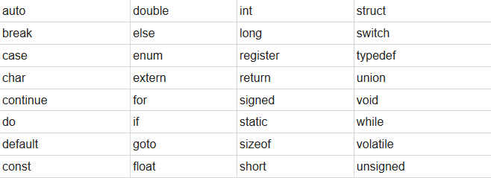
Keywords in C
Keywords are predefined, reserved words in C language and each of which is associated with specific features.
These words help us to use the functionality of C language. They have special meaning to the compilers.
There are total 32 keywords in C.

